Slide 1
Lecture 17
User and Kernel Threads
National University of
Computer & Emerging Sciences

Slide 2
What is a process?
A computer program in execution on a machine is a process
More formally:
  A Sequential stream of Execution in its own address space

Slide 3
Process Characteristics
Concept of Process has two facets.
A Process is:
  A Unit of resource ownership:
    a virtual address space for the process image
    control of some resources (files, I/O devices...)
  A Unit of execution - process is an execution path through one or more programs
    may be interleaved with other processes
    execution state (Ready, Running, Blocked...) and dispatching priority

Slide 4
Process Characteristics
These two characteristics are treated separately by some recent operating systems:
  The unit of resource ownership is usually referred to as a process or task
  The unit of execution is usually referred to a thread or a “lightweight process”

Slide 5
Its better to distinguish between the two concepts
  Address space/Global Variables
  Open files
  Child processes
  Accounting info
  Signal handlers
  Program counter
  Registers
  Stack
  State
Heavy weight process
In case of multiple threads per process
Unit of Resource
Split
Unit of Execution/Dispatch
  Program counter
  Registers
  Stack
  State
Light weight processes
  Address space/Global Variables
  Open files
  Child processes
  Accounting info
  Signal handlers
  Program counter
  Registers
  Stack
  State
  Program counter
  Registers
  Stack
  State
Share

Slide 6

Single and Multithreaded Processes

Slide 7
Thread Usage
Less time to create a new thread than a process
    the newly created thread uses the current process address space
    no resources attached to them
Less time to terminate a thread than a process.
Less time to switch between two threads within the same process, because the newly created thread uses the current process address space.
Less communication overheads
    threads share everything: address space, in particular. So, data produced by one thread is immediately available to all the other threads
Performance gain
    Substantial Computing and Substantial Input/Output
Useful on systems with multiple processors

Slide 8
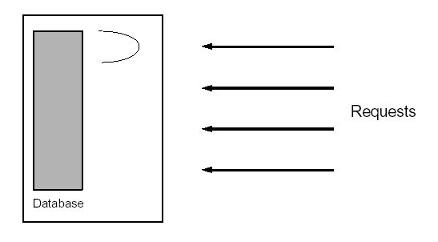
1. Single threaded database server
Handles multiple clients
  Either handle the requests sequentially
  Or multiplex explicitly by creating multiple processes
Problem with 1
  Unfair for quick requests, occurring behind lengthy requests
Problem with 2
  Complex and error prone
  Heavy IPC required

Slide 9
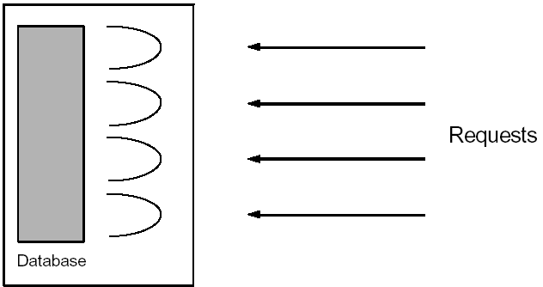
1. Multithreaded database server
Assign a separate thread to each request
As fair as in the multiplexed approach.
The code is as simple as in the sequential approach, since the address space is shared => all variables are available
Some synchronization of access to the database is required, this is not terribly complicated.

Slide 10
When to use threads?
If a program can be organized into discrete, independent tasks which can execute concurrently

Slide 11
User Threads vs Kernel Threads
User Thread - management done by user-level threads library
Supported by the Kernel
    Windows XP/2000, Linux, Mac OS X…

Slide 12
User-Level Threads (ULT) (ex. Java)
Kernel not aware of the existence of threads
Thread management handled by thread library in user space
No mode switch (kernel not involved)
But I/O in one thread could block the entire process!

Slide 13
Threads library
Contains code for:
  creating and destroying threads
  passing messages and data between threads
  scheduling thread execution
    pass control from one thread to another
  saving and restoring thread contexts
ULT’s can be be implemented on any Operating System, because no kernel services are required to support them

Slide 14
Kernel Role for ULTs (None!)
The kernel is not aware of thread activity
  it only manages processes
If a thread makes an I/O call, the whole process is blocked
  Note: in the thread library that thread is still in “running” state, and will resume execution when the I/O is complete
So thread states are independent of process states

Slide 15
Advantages and disadvantages of ULT
Advantages
Thread switching does not involve the kernel: no mode switching
Therefore fast
Scheduling can be application specific: choose the best algorithm for the situation.
Can run on any OS. We only need a thread library
Disadvantages
Most system calls are blocking for processes. So all threads within a process will be implicitly blocked
The kernel can only assign processors to processes. Two threads within the same process cannot run simultaneously on two processors

Slide 16
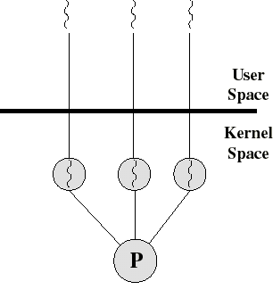
Kernel-Level Threads (KLT)
Ex: Windows NT, Windows 2000, OS/2
All thread management is done by kernel
No thread library; instead an API to the kernel thread facility
Kernel maintains context information for the process and the threads
Switching between threads requires the kernel
Kernel does Scheduling on a thread basis

Slide 17
Advantages and disadvantages of KLT
Advantages
The kernel can schedule multiple threads of the same process on multiple processors
Blocking at thread level, not process level
  If a thread blocks, the CPU can be assigned to another thread in the same process
Even the kernel routines can be multithreaded
Disadvantages
Thread switching always involves the kernel. This means 2 mode switches per thread switch
So it is slower compared to User Level Threads
  (But faster than a full process switch)

Slide 18
Multithreading Models
Many-to-One
One-to-One
Many-to-Many

Slide 19
Many-to-One
Many user-level threads mapped to single kernel thread
Examples:
  Solaris Green Threads
  GNU Portable Threads

Slide 20
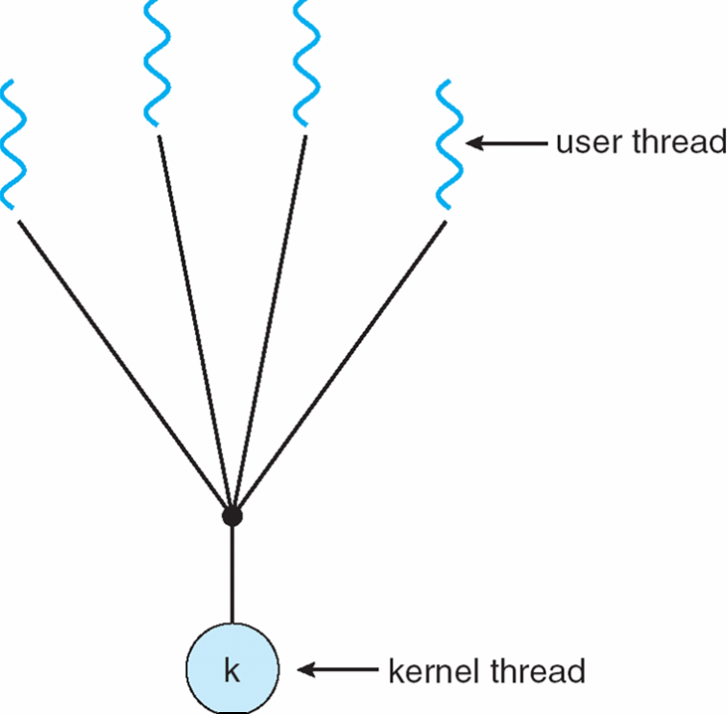
Many-to-One Model

Slide 21
One-to-One
Each user-level thread maps to kernel thread
Examples
  Windows NT/XP/2000
  Linux
  Solaris 9 and later

Slide 22
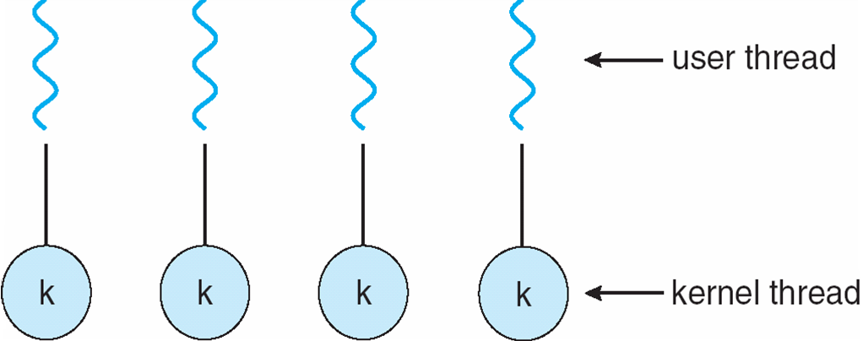
One-to-one Model

Slide 23
Many-to-Many Model
Allows many user level threads to be mapped to many kernel threads
Allows the operating system to create a sufficient number of kernel threads
Solaris prior to version 9
Windows NT/2000 with the ThreadFiber package

Slide 24

Many-to-Many Model

